Slide 1
NP-hard and NP- complete

Slide 2
Polynomial Vs Non Polynomial
A Polynomial is any algebraic expression that consists of more than 2 terms in which the only allowable exponents are whole numbers, the variable is never used as a divisor and never appears under a radical sign. Technically, many consider polynomials to consist of 4 terms or more because 2 and 3 term equations are named.
Monomial (One term): 3w
Binomial (Two terms): 3w - 4x
Trinomial (Three terms): 3w - 4x + 6y
Polynomial : 3w-4x+6y+7z

Slide 3
Polynomial Vs Non Polynomial
A polynomial in x is an expression that can be written in the form: a*x^{n} + b*x^{n-1} + ... + c*x⁰ Where 'n' is a non-negative integer, 'a', 'b', and 'c' are constant scalars, where a ≠ 0. In algebra class, it is usually written in the form of a function f such as:
f(x) = 3x² + 4x¹ + 1x⁰ = 3x²+4x+1
Any value of x for which f(x) = 0 is a root of the equation and a zero of the function.

Slide 4
Polynomial Vs Non Polynomial
A polynomial is a finite length expression constructed from variables (also known as in determinates) and constants, by using the operations of addition, subtraction, multiplication, and constant non-negative whole number exponents. For example, x² − 4x + 7 is a polynomial, but x² − 4/x + 7x^{3/2} is not, because its second term involves division by the variable x and also because its third term contains an exponent that is not a whole number.
A polynomial consists only of powers of the variables - ie the variables multiplied by themselves or one another. A non-polynomial can include any other function such as trigonometric, exponential, logarithmic etc.

Slide 5
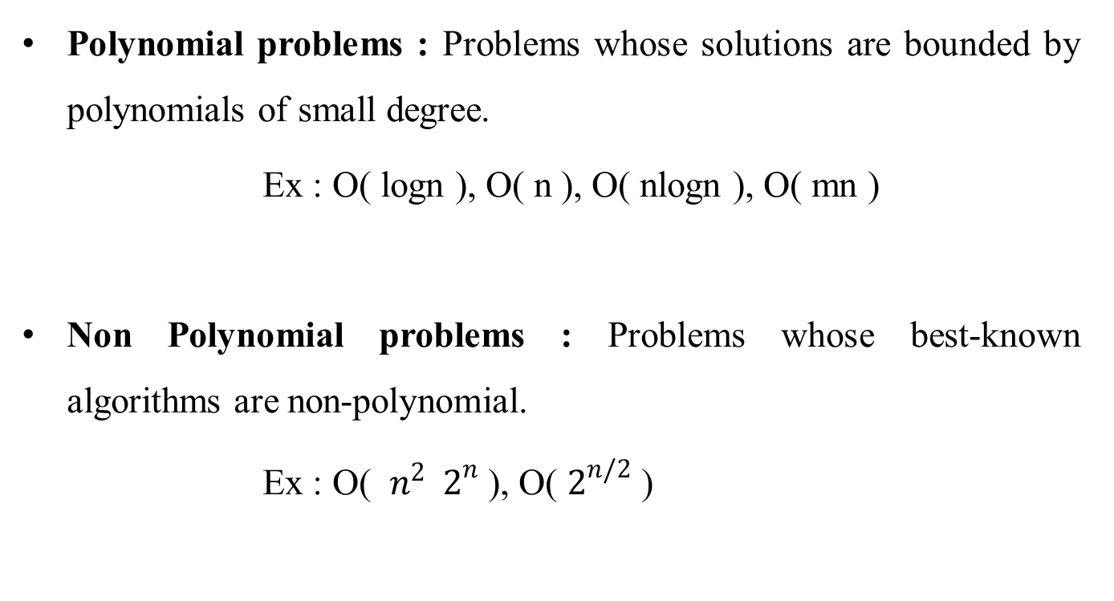
Polynomial Vs Non Polynomial
Polynomial problems : Problems whose solutions are bounded by polynomials of small degree.
Ex : Ο( logn ), Ο( n ), Ο( nlogn ), Ο( mn )
Non Polynomial problems : Problems whose best-known algorithms are non-polynomial.
Ex : Ο( $n^{2 }$ $2^{n}$ ), Ο( $2^{n/2}$ )

Slide 6
NP-hard and NP- complete
Decision problem : Any problem for which the answer is either zero or one is called a decision problem.
Optimization problem : Any problem that involves the identification of an optimal value of a given cost function is known as optimization problem.
Deterministic algorithm : An algorithm that has the property that the result of every operation is uniquely defined.
Non deterministic algorithm : An algorithm operations, whose outcomes are not uniquely defined but are limited to specified set of possibilities.

Slide 7
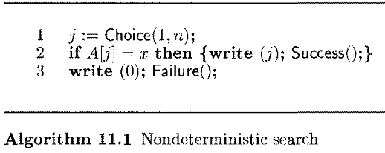
Non deterministic algorithm

Slide 8
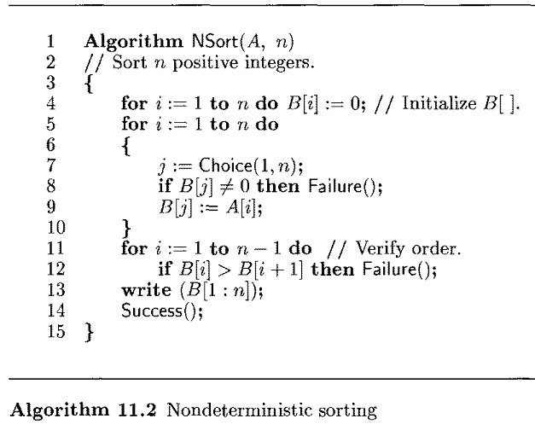
Non deterministic algorithm

Slide 9
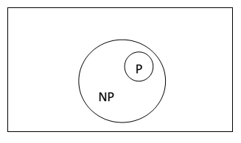
NP-hard and NP- complete
The classes NP-hard and NP- complete
An algorithm A is of polynomial complexity if there exists a polynomial P( ) such that the computing time of A is Ο( P( n ) ) for every input of size n.
P is the set of all decision problems solvable by deterministic algorithms in polynomial time.
NP is the set of all decision problems solvable by nondeterministic algorithms in polynomial time.

Slide 10
NP-hard and NP- complete
Cook theorem : Satisfiability is in P if and only if P = NP.
Satisfiability : It determines whether a formula is true for some assignment of truth values to the variables.
Let L1 and L2 be problems. Problem L1 reduces to L2 ( also written L1 α L2 ) if and only if there is a way to solve L1 by a deterministic polynomial time using a deterministic algorithm that solves L2 in polynomial time.
Two problems L1 and L2 are said to be polynomial equivalent if and only if L1 α L2 and L2 α L1.

Slide 11
NP-hard and NP- complete
A problem L is NP-hard if and only if satisfiabiliy reduces to L (satisfiability α L).
Ex : Optimization problems.
A problem L is NP-complete if and only if L is NP-hard and L Є NP.
Ex : Decision problems
Optimization problems can’t be NP- complete whereas decision problems can.

Slide 12
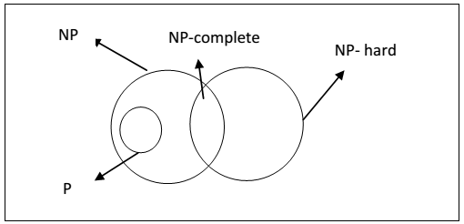
NP-hard and NP- complete
A problem that is NP-complete has the property that it can be solved in polynomial time if and only if all other NP-complete problems can also be solved in polynomial time.
If an NP-hard problem can be solved in polynomial time, then all NP-complete problems can be solved in polynomial time.

Slide 13
NP-hard and NP- complete
BACKTRACKING
It is effective for decision problems.
If we get a solution then we will terminate the search procedure in Backtracking.
BRANCH AND BOUND
It is applicable to Optimization problems ( only for minimization problems ).
We will continue the search procedure until we get an optimal solution.

Slide 14
NP-hard and NP- complete
DYNAMIC PROGRAMMING
We will make more than one decision at a time.
It is applicable when sub problems are not independent.
It solves every sub problem just once.
GREEDY METHOD
We will make one decision at a time.

